Slide 1
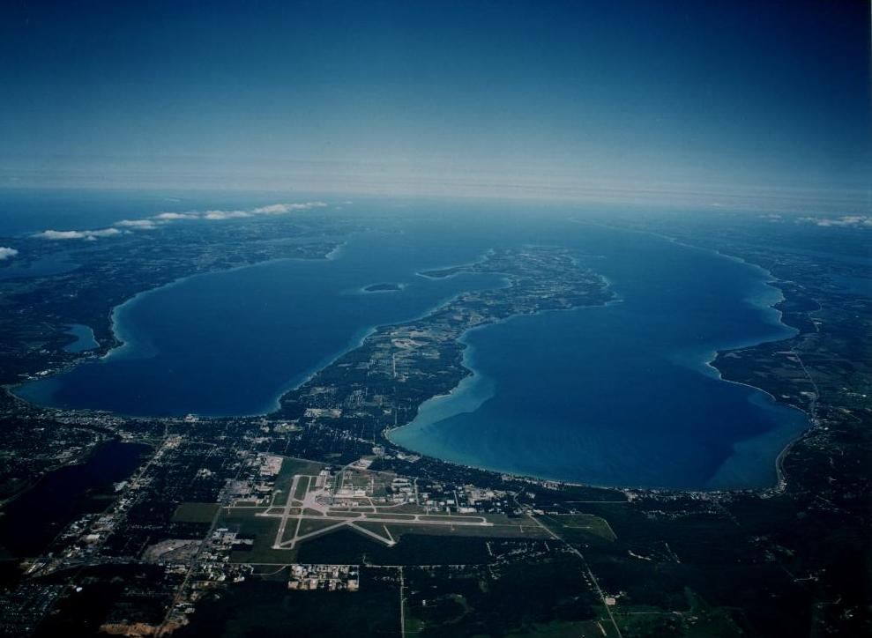
Torch Lake Water Quality Trends
and the National Lakes Assessment
Dennis McCauley and Michelle VandenBrand
Great Lakes Environmental Center, Inc., Traverse City, MI

Slide 2
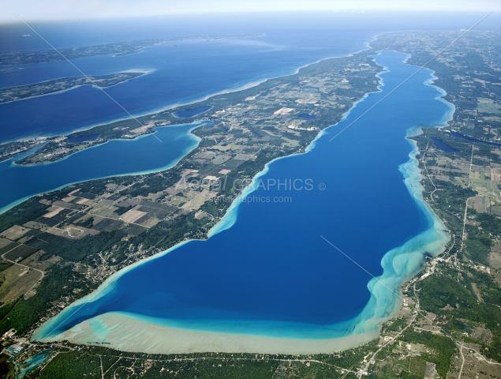
Torch Lake
18,770 acres (7,596 hectares),
Max. depth of 87 meters (288 feet),
Average depth of 111 feet,
Michigan’s deepest inland lake,
41 miles of shoreline,
Approximately 2 miles wide (3.2 Km) at its widest point.
Michigan’s second largest lake; second to Houghton Lake (20,044 acres).

Slide 3
TORCH LAKE WATER QUALITY TRENDS
DATA SOURCES
  1990-2017
  Antrim County Conservation District
  Cooperative Lake Monitoring Data
  2017 National Lakes Assessment
Water Transparency
Chlorophyll @
Total Phosphorus
Temperature

Slide 4
SUMMARY OF WATER QUALITY PARAMETERS FOR THE NORTH AND SOUTH BASINS OF TORCH LAKE: 1976-2017
Parameter | Location | Minimum value (date recorded) | Maximum value (date recorded) | Average | Number of data points
Total Phosphorus (µg/L) | Torch Lake, North | 1.5 (12 events) | 14 (September 2004) | 3.3 | 23
 | Torch Lake, South | 1.5 (13 Events) | (2004) | 3.5 | 26
Secchi Disk Depth (feet) | Torch Lake, North | 12 (September 2004) | 45 (June 2007) | 27 | 323
 | Torch Lake, South | 11 (September 1995) | 52 (June 2017) | 25 | 356
Chlorophyll a (µg/L) | Torch Lake, North | 0.12 (June 1996) | 1.20 (July 1990) | 0.45 | 105
 | Torch Lake, South | 0.05 (July 1995) | 1.40 (June 1990) | 0.43 | 128
Water Temperature (°C) | Torch Lake, North | 11.7 (June 2003) | 21.6 (August 2003) | 17.7 | 12
 | Torch Lake, South | 16.0 (June 2003) | 28.3 (June 2001) | 21.5 | 22
Air Temperature (°C) | Torch Lake, North | 14.4 (September 1997) | 26.7 (September 1996) | 23.0 | 23
 | Torch Lake, South | 15.6 (June 1994) | 31.1 (August 1995) | 21.6 | 59

Slide 10
BOX PLOT OF CHLOROPHYLL @ DATA FOR THE NORTH AND SOUTH BASINS OF TORCH LAKE: 1990-2003

Slide 11
TOTAL PHOSHORUS DATA FOR THE NORTH AND SOUTH BASINS OF TORCH LAKE: 1990-2017

Slide 12
SEASONAL VARIATION IN TOTAL PHOSPHORUS CONCENTRATION FOR THE NORTH BASIN OF TORCH LAKE: 2004-2017

Slide 13
SEASONAL VARIATION IN TOTAL PHOSPHORUS CONCENTRATION FOR THE SOUTH BASIN OF TORCH LAKE: 2004-2017

Slide 14
Future Monitoring
Standardized data collection
Field and Laboratory Quality Control
Choose the parameters for long-term trend monitoring
Ice Cover

Slide 15
Torch Lake 2017
National Lakes Assessment
The Watershed Center – Grand Traverse Bay
Funding Partners:
Dole Family Foundation
Three Lakes Association
Torch Conservation Center
Torch Lake Protection Alliance

Slide 16
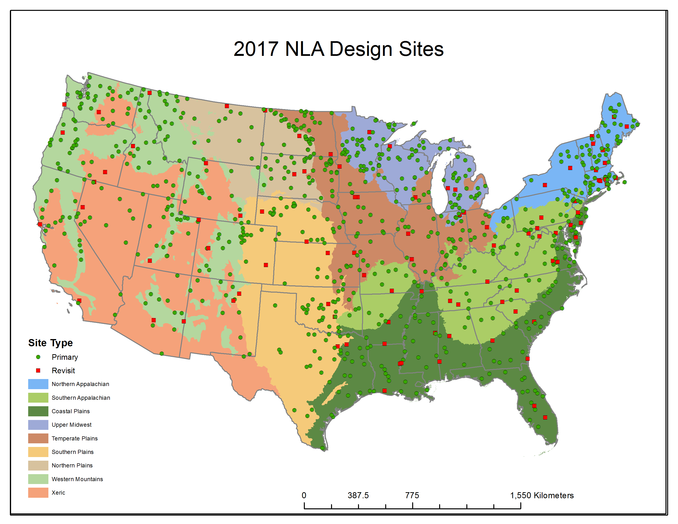
2017 National Lakes Assessment

Slide 17
Torch Lake “X” Point
44.960000N and -85.29362W

Slide 18
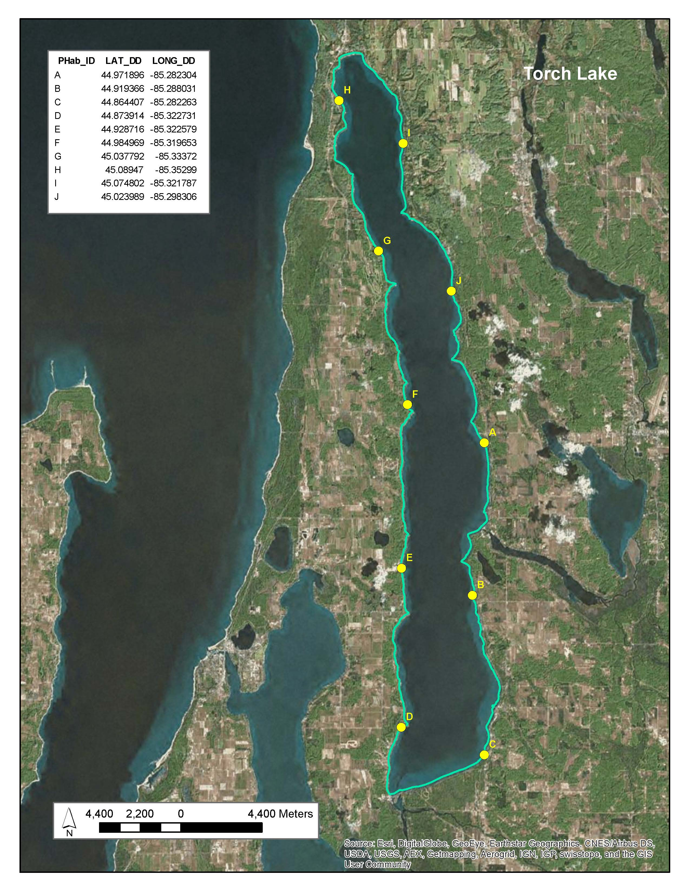

Slide 19
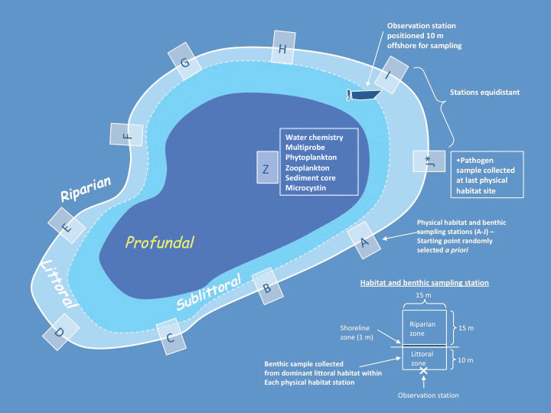

Slide 20
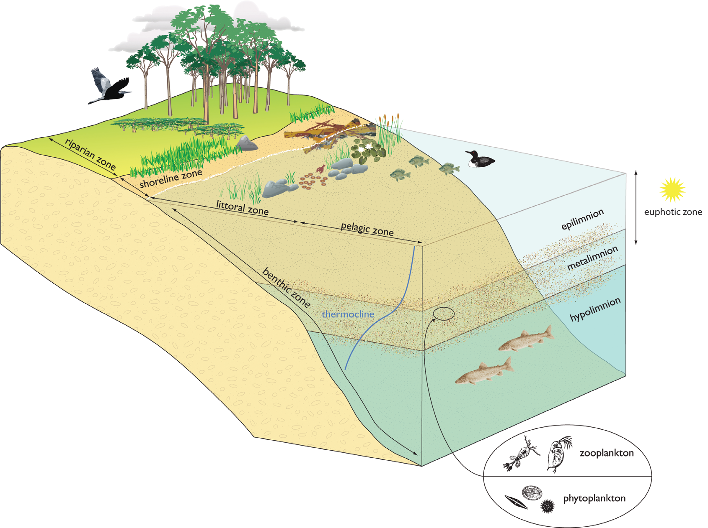

Slide 21
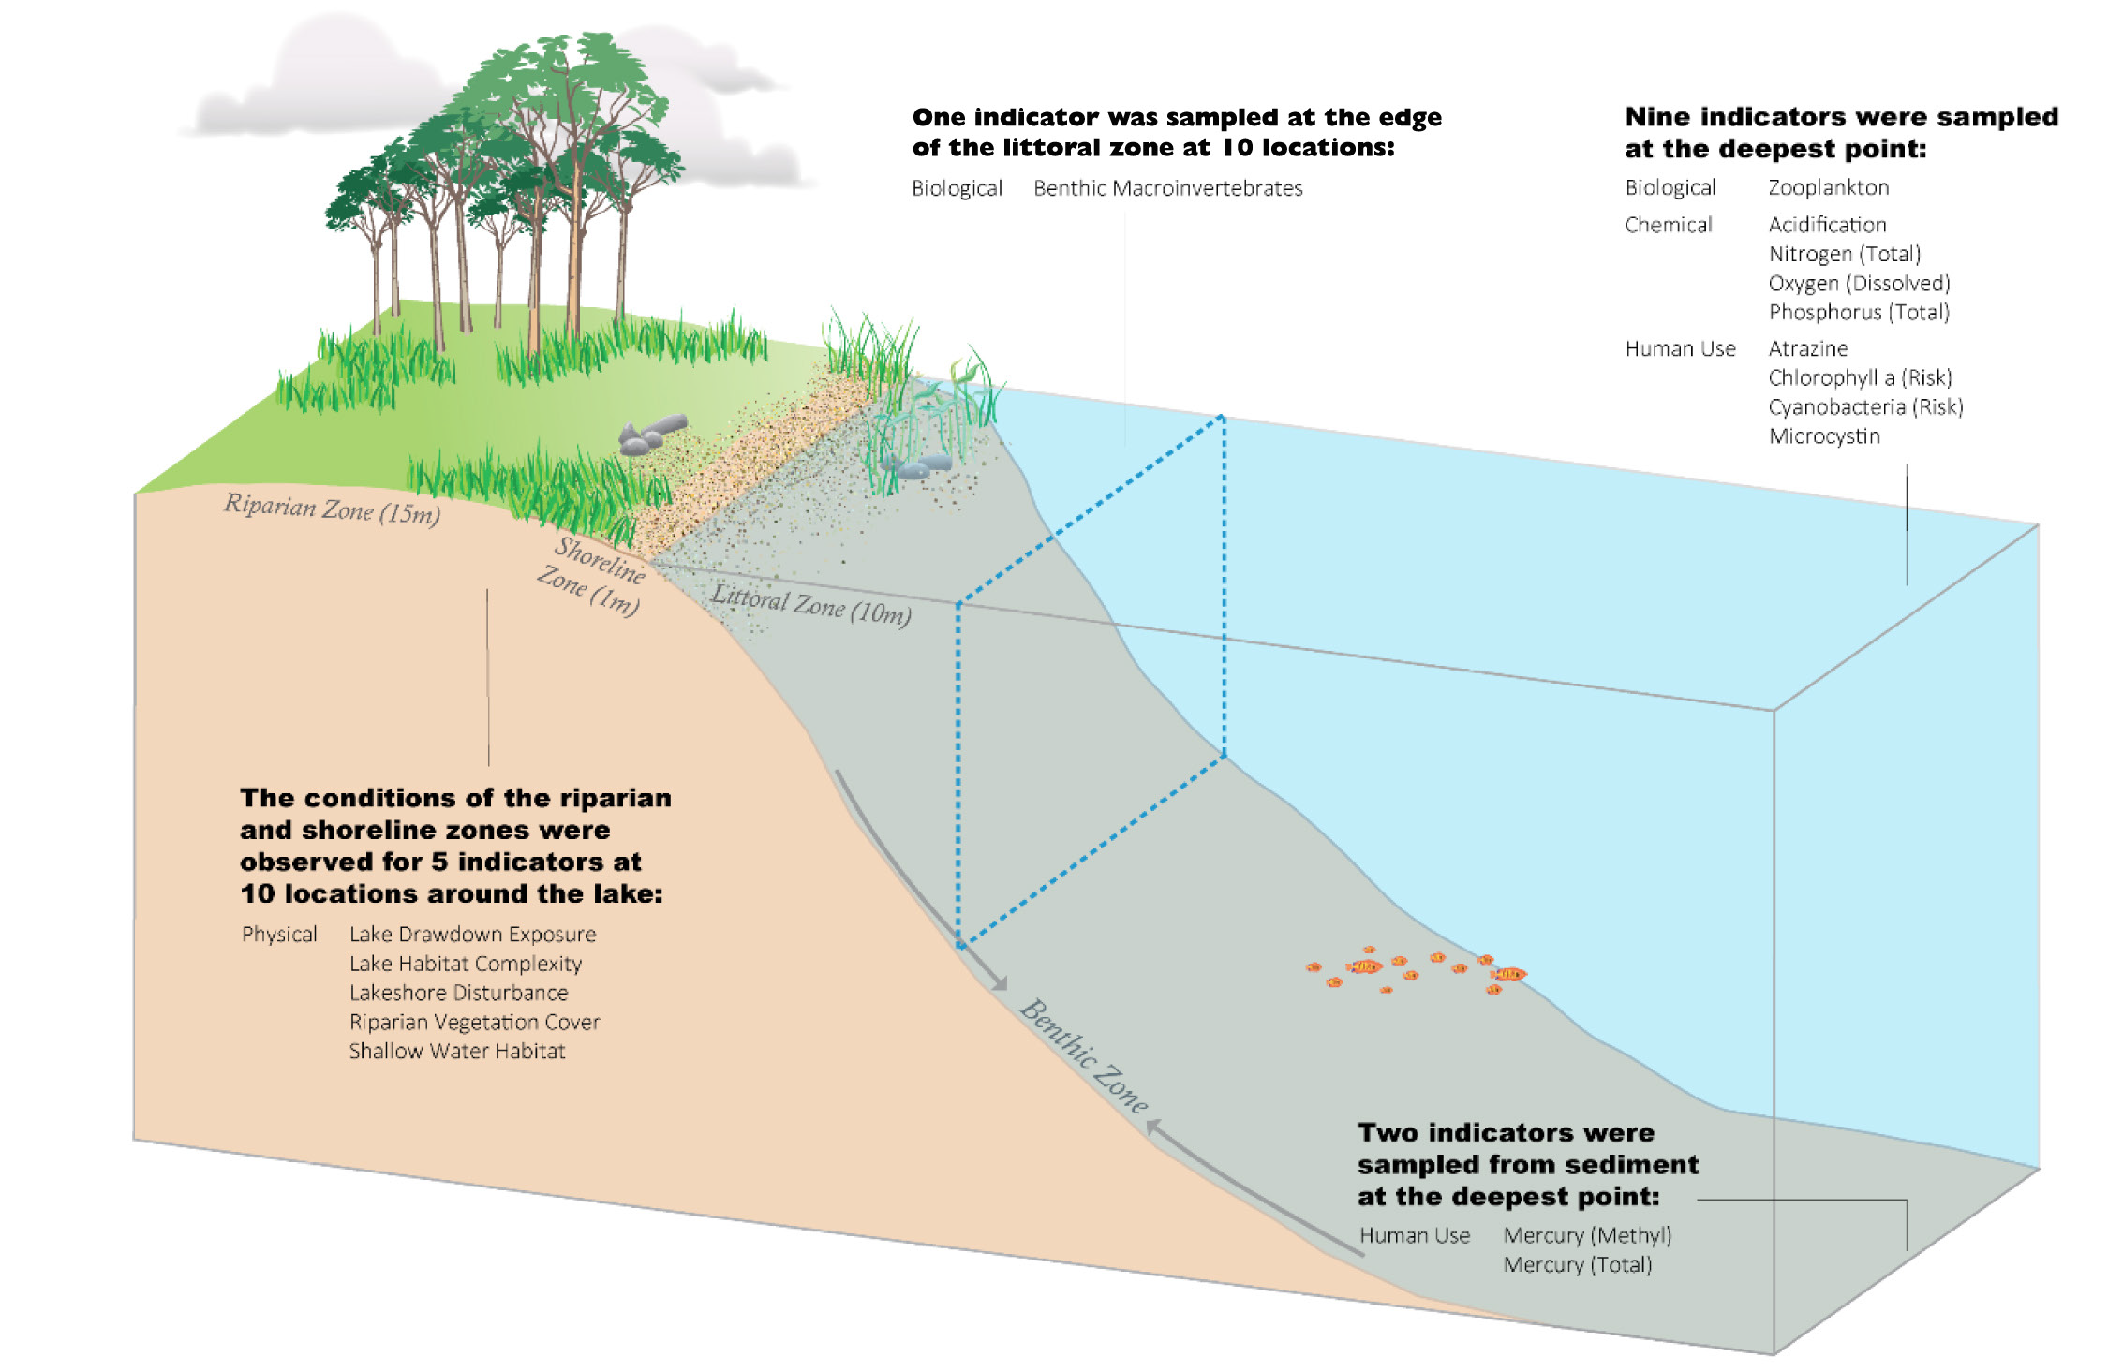

Slide 22
Least-disturbed Reference Screening Filter Thresholds for NLA 2012
(Upper Midwest Ecoregion is labeled as UMW )
¹ WMT = Western Mountains; ² XER = western Xeric, ³ NPL = Northern Plains, ⁴ SPL = Southern Plains, ⁵ TPL = Temperate Plains, ⁶ UMW = Upper Midwest, ⁷ Central Plains, ⁸ Southern Appalachians, ⁹ NAP = Northern Appalachians, ¹⁰ Lakeshore Physical Habitat disturbances; non-agricultural,
¹¹ Lakeshore Physical Habitat disturbances; agricultural, ¹² Sum of agricultural/residential/industrial human disturbances
 | TP (ug/L) | TN (ug/L) | Cl (ueq/L) | SO4 (ueq/L) | Turbidity (NTU) | Hii-NonAg¹⁰ | Hii-Ag¹¹ | Assessment (Ag/Res/Ind)¹²
WMT ¹ | >30@ | >400 | >100# | >200 | >3 | >0.6 | >0 | > 5/5/5
XER ² | >100 | >1000 | >500 | >1000 | >5 | >1.5 | >0.2 | > 5/5/5
NPL ³ | >150 | >2000 | >1000 | --- | >5 | >1.5 | >0.5 | > 10/6/6
SPL⁴ | >150* | >2000* | >1000 | --- | >5 | >1.5 | >0.5 | > 10/6/6
TPL⁵ | >120 | >2000 | >1000 | >5000 | >5.5 | >1.7 | >0.15 | > 9/9/9
UMW⁶ | >40 | >1200 | >200 | >200 | >5 | >0.6 | >0 | > 5/5/5
CPL⁷ | >50 | >1200 | >1000 | >400 | >5 | >1.0 | >0 | > 6/10/6
SAP⁸ | >35 | >800 | >125 | >300 | >5 | >0.9 | >0 | > 6/6/6
NAP⁹ | >30 | >600 | >100# | >300 | >5 | >0.6 | >0 | > 6/6/6

Slide 23
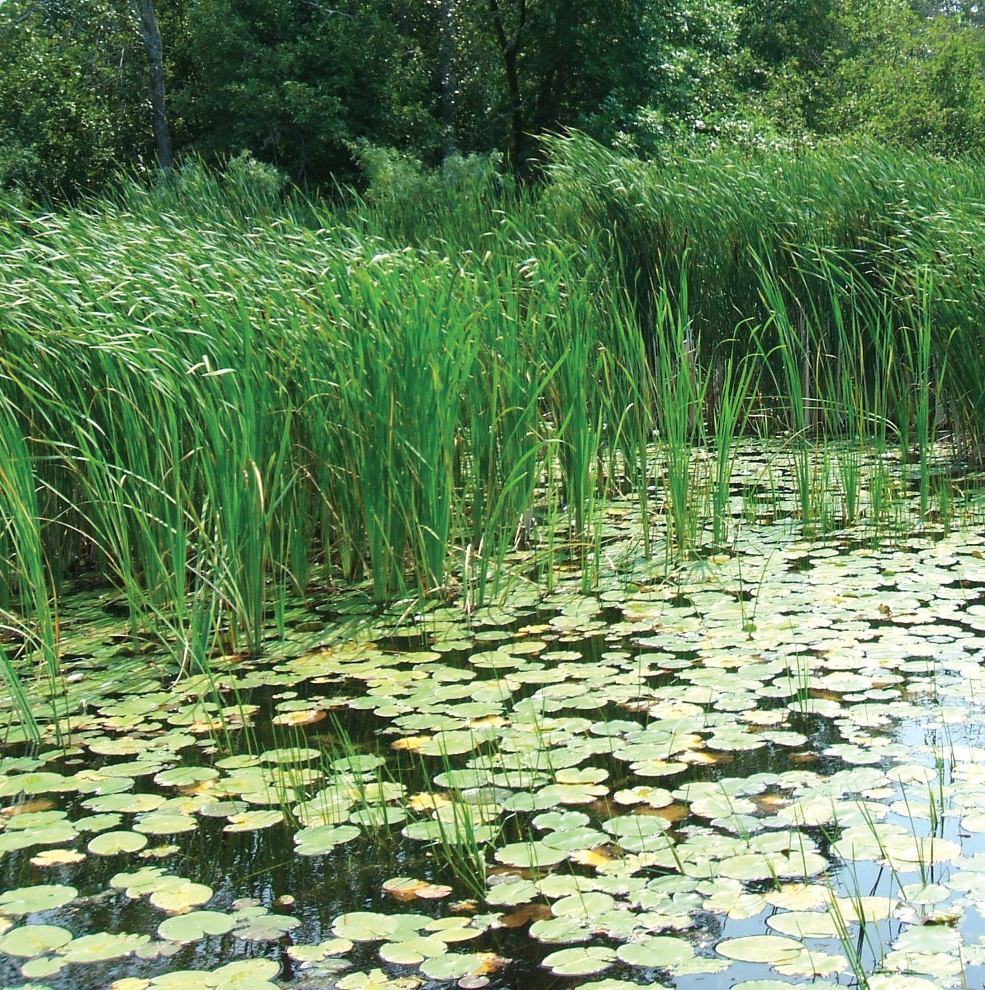

Slide 24
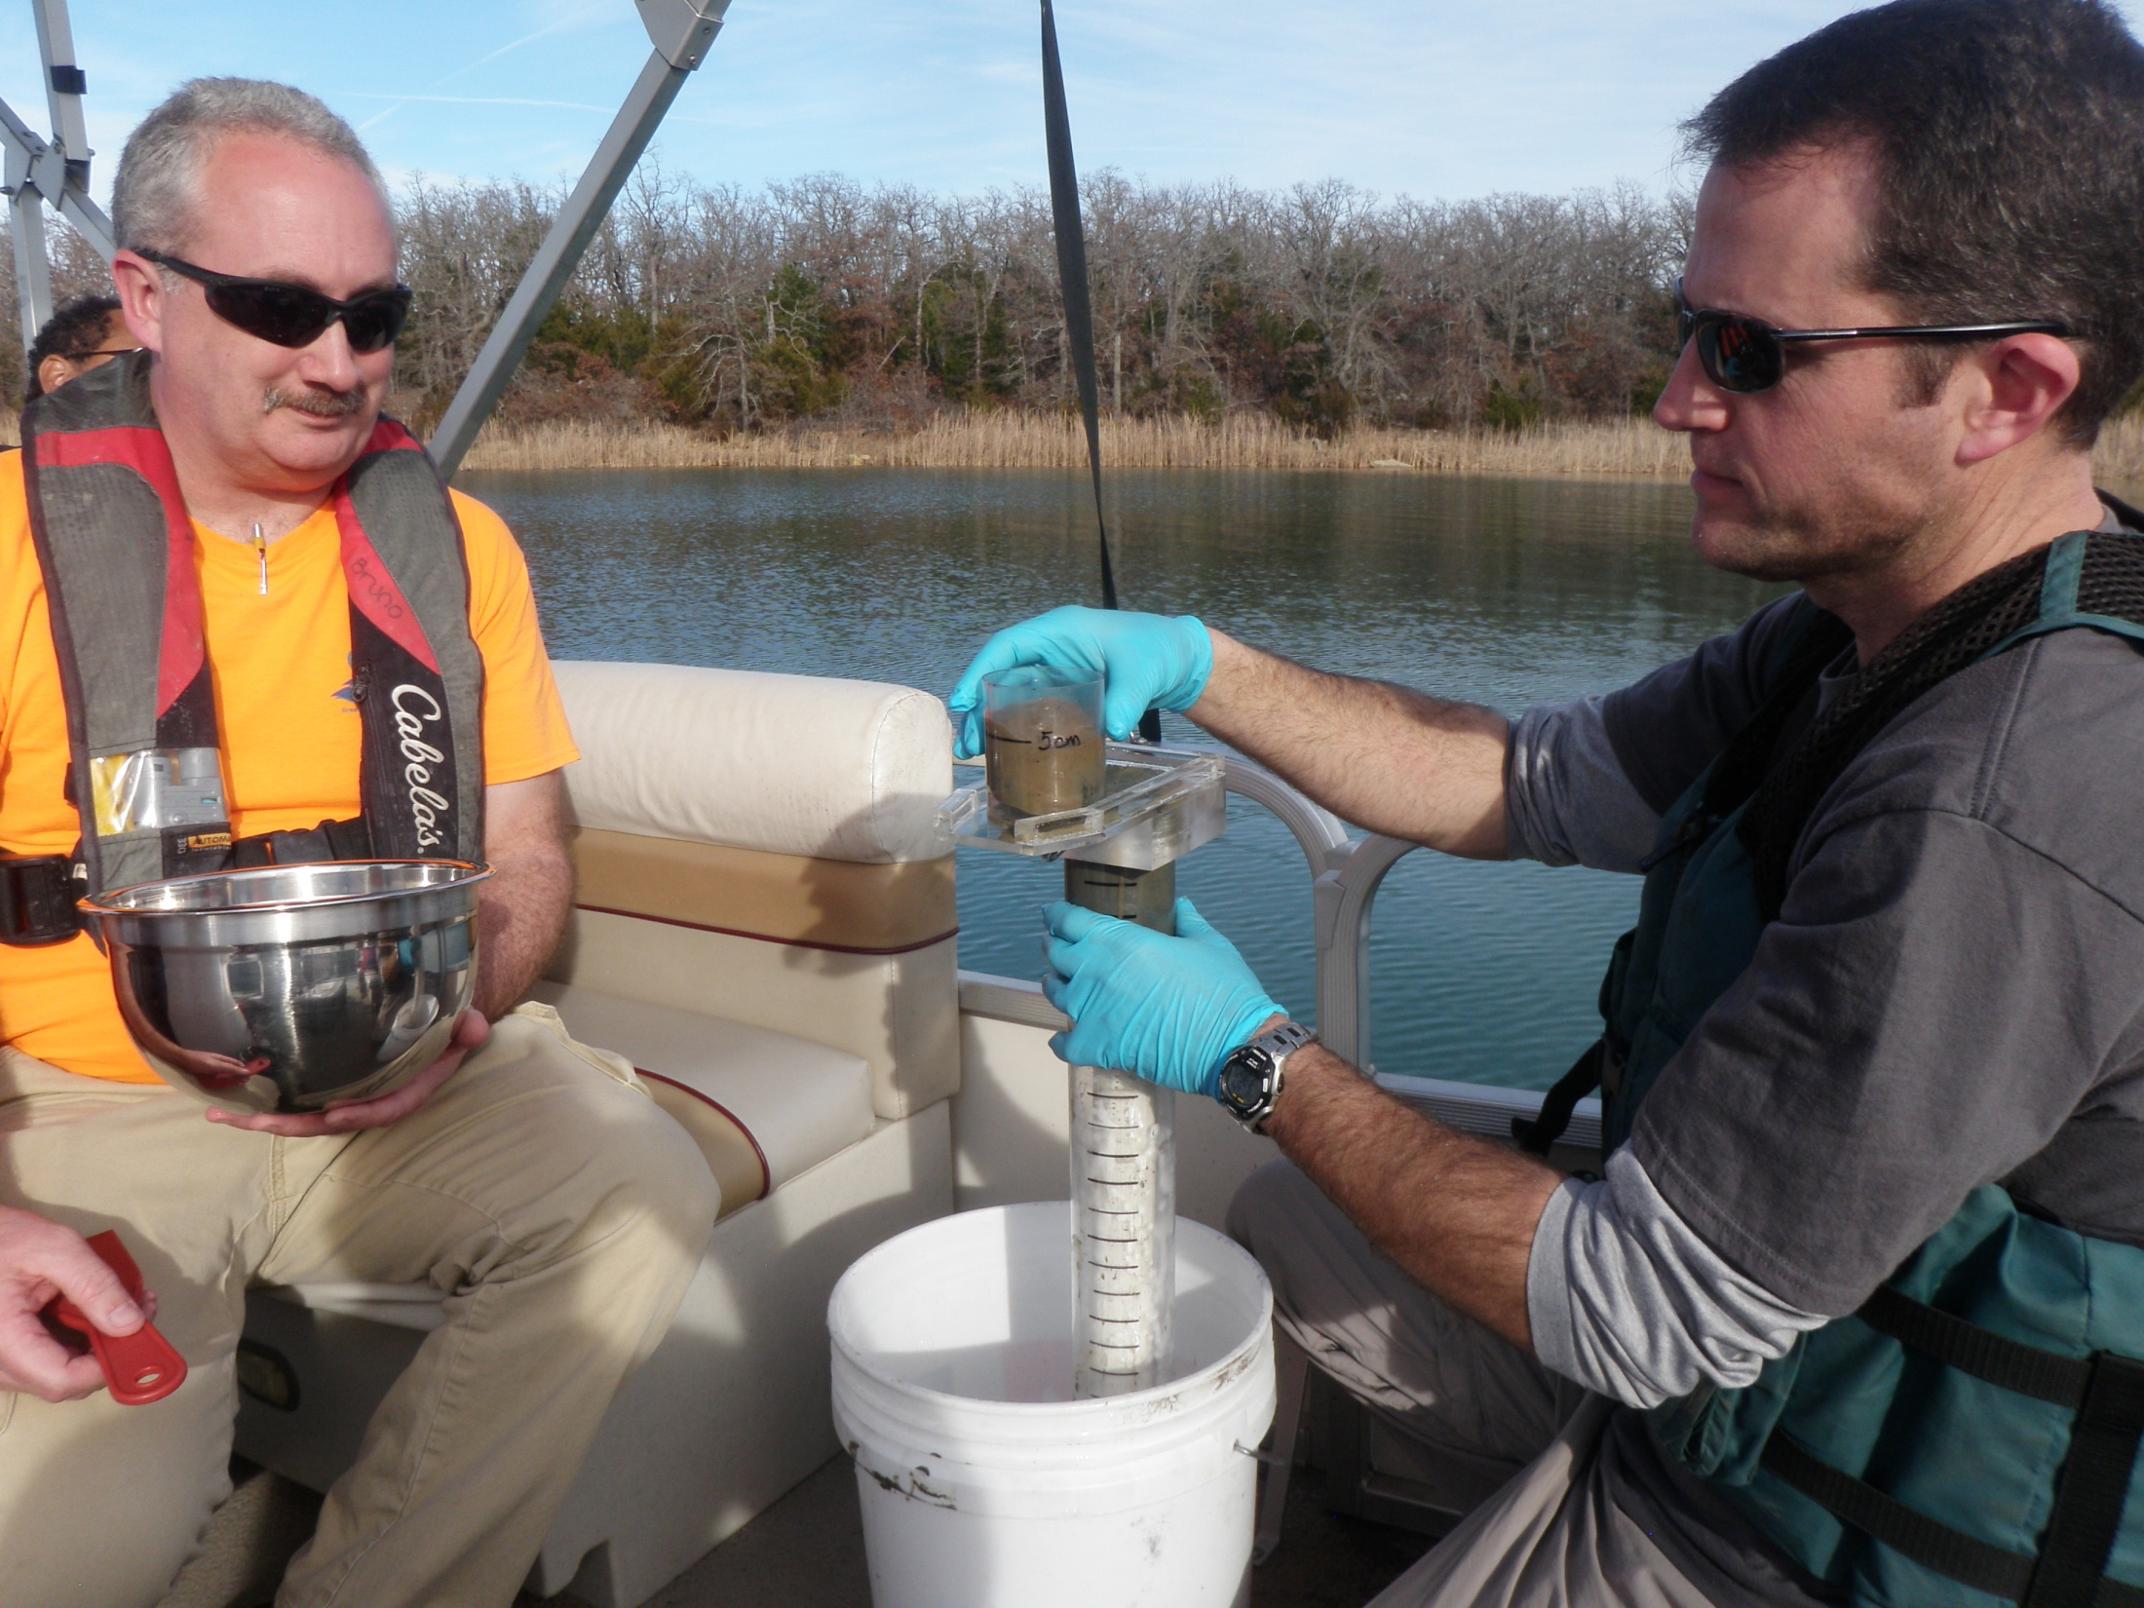

Slide 25
Water and Sediment Quality Analysis: Torch Lake 2017
NLA Indicators |  | Torch Lake Results
Sample Type | Analyses
Water chemistry | pH | 8.24
nutrients | TOTAL PHOSPHORUS | <0.0007
nutrients | TKN | 0.458 mg/L
 | Chlorophyll a | 0.00033 mg/L
Bacteria | E.coli | <1 (MPN)
Bacteria | Total Coliforms | 5.2 (MPN)
Algal Toxin | Microcystin | 0.001 µg/L
Sediment | Total Organic Carbon | 3.8%
Sediment | grain size | Clay: 26.1%, Sand: 35.0%, Silt: 29.1%
Sediment | Chlorinated Pesticides | <1 ng/dry gram (<mdl)
Sediment | Total PCBs | <1 ng/dry gram (<mdl)
Sediment | Total PAHs | 14.0 ng/dry gram
Sediment | Percent Solids | 73.8%
Sediment | Metals (µg/L) : Aluminum | 3249/3640
 | Antimony | 0/0
 | Arsenic | 4.16/4.12
 | Cadmium | 0/0
 | Chromium | 5.9/6.2
 | Copper | 5.9/7.6
 | Iron | 5665/5667
 | Lead | 1.7/1.7
 | Manganese | 179/178
 | Mercury | 0.0053/0.0046
 | Nickel | 3.4/3.4
 | Selenium | 0.091/0.112
 | Silver | 0/0
 | Tin | 0.45/0.52
 | Vanadium | 10.7/10.9
 | Zinc | 8.2
Triazine Pesticides (water) | Atrazine Screen | 0 µg/L

Slide 27
Comparison of Selected Water Quality and Physical Habitat Indices (Rating Over Index Value) From Two Northern Michigan Lakes and Torch Lake
Lake | Trophic Status | DO¹ | Chl.² @ | Draw- down | LitCvr³ | LitRipCvr⁴ | RDIS⁵ | RVeg.⁶ | Total Phosphorus (mg/L) | Sechi Depth (m)
Torch | Oligotrophic | High | Good (0.00033) | small | Poor (2.91) | Poor (1.5) | Poor (0.427) | Poor (0.11) | <0.0007 | 11.5
Clear | Oligotrophic | High | Good | Med. | Poor (0.071) | Poor (0.305) | Fair (0.487) | Poor (0.447) | 21 | 8.8
Glenn | Oligotrophic | High | Good | Small | Poor 0.217) | Poor (0.424) | Poor (0.753) | Fair (0.560) | 23 | --
¹ Dissolved Oxygen, ² Chlorophyll @, ³ Littoral Cover, ⁴ Avg. Littoral and Riparian Cover, ⁵ Anthropogenic Disturbance, ⁶ Riparian Cover Complexity

Slide 28
Comparison of the Least Disturbed Condition in the Upper Midwest EcoRegion to Torch Lake (2017)
 | TP (ug/L) | TN (ug/L) | Cl (ueq/L) | SO4 (ueq/L) | Turbidity (NTU)
UMW | >40 | >1200 | >200 | >200 | >5
Torch | <7 | 458 |  |  | >5

Slide 29
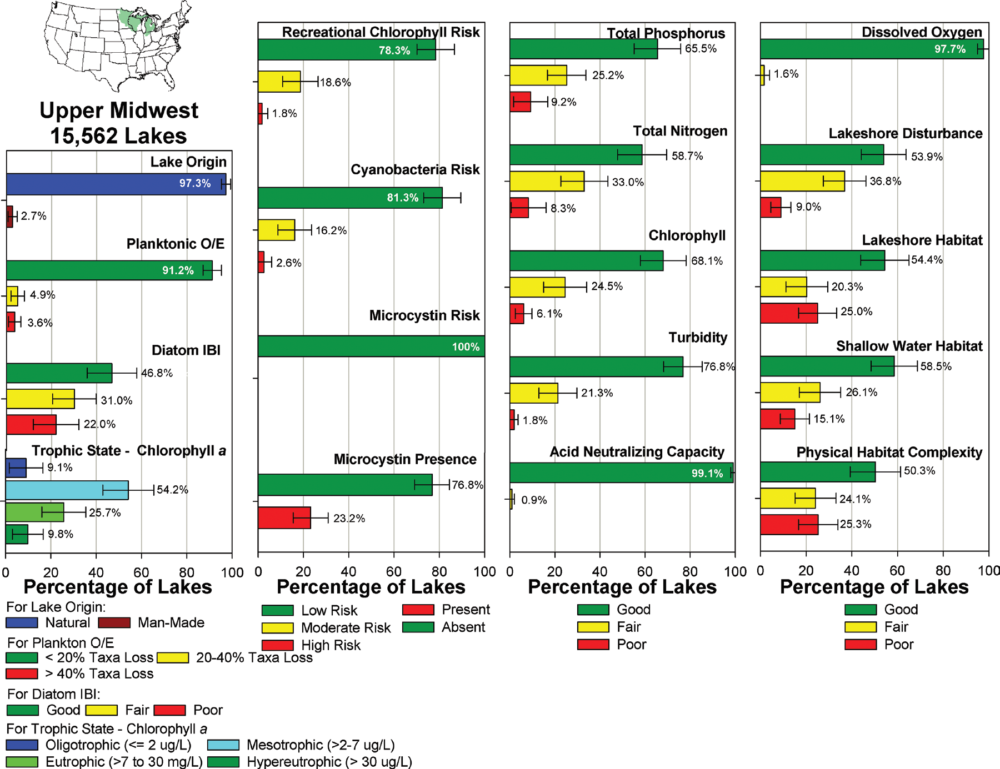

Slide 30
“Given these indicators and similar scoring, Torch Lake would also likely rank in the “Good” category nationally.”

Slide 31
QUESTIONS ?

